Slide 1
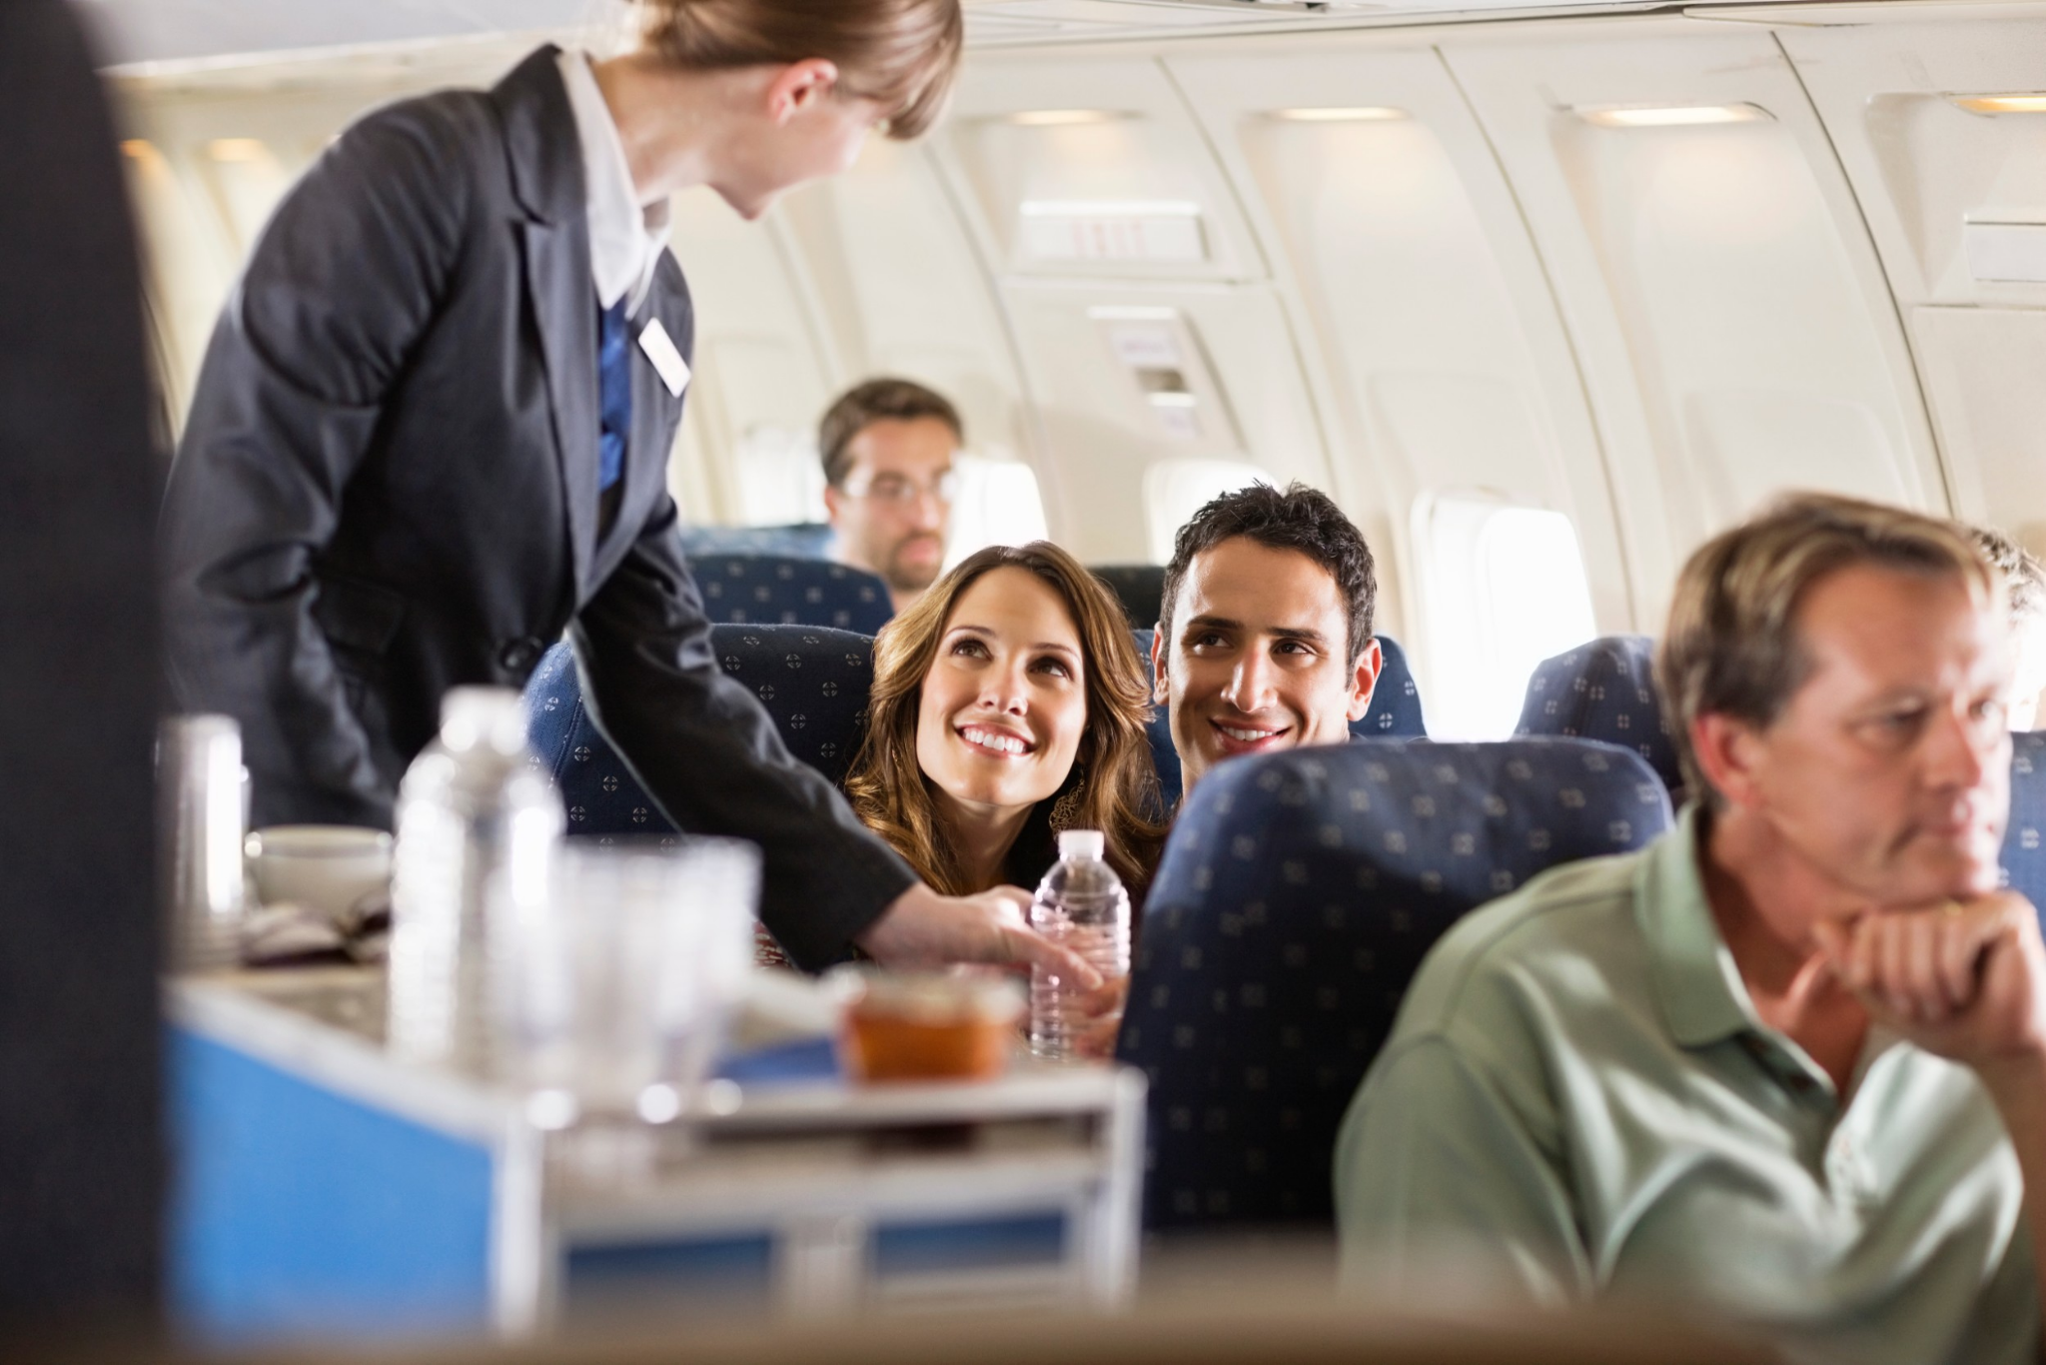
Predicting Satisfaction of Airline Passengers

Slide 2
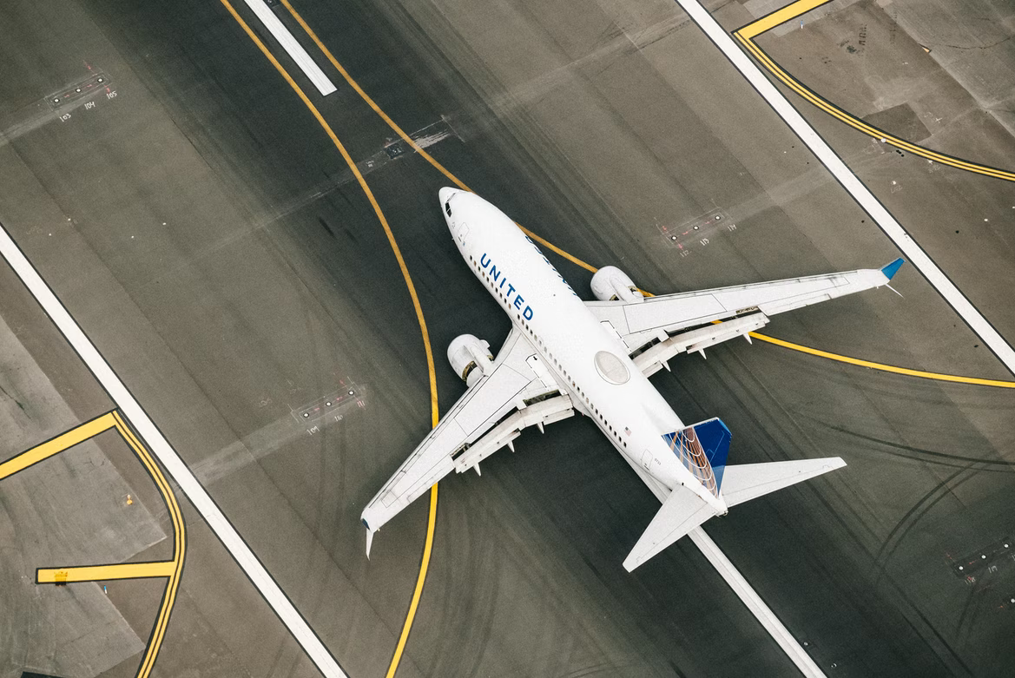
How does our Model help?
Kaggle Dataset containing 130K flight satisfaction survey data.
Data is taken from passengers from a US airline.
Goal: Identify critical factors that ensure satisfaction.
Focus on Precision of our machine learning model.

Slide 3


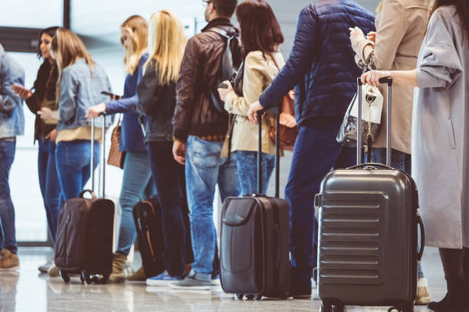
Model Strategy:
Satisfaction plays a key role in determining whether user will return or not.
Model tries to predict satisfaction for a passenger based on provided features.
Analyze importance of feature to determine which factors can be improved to convert a First-time passenger to the returning passenger group.

Slide 4


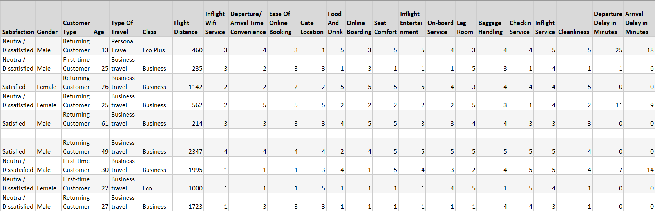
Understanding the dataset
Target

Slide 5
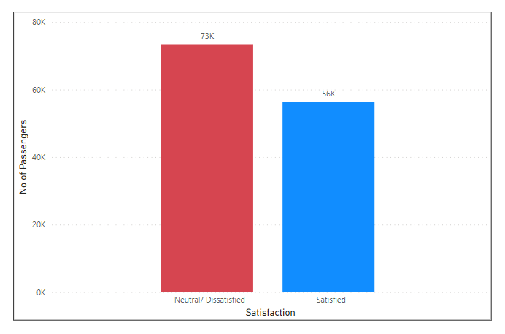
Target Variable
Satisfaction: Airline satisfaction level
Values:
Satisfaction
Neutral/Dissatisfaction)
Key Points:
Dataset appears to be balanced based on Satisfaction response
‘Neutral/Dissatisfied’ does not necessarily mean dissatisfaction.

Slide 6

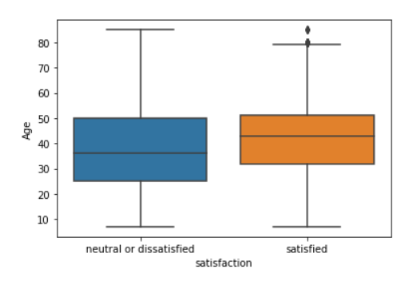
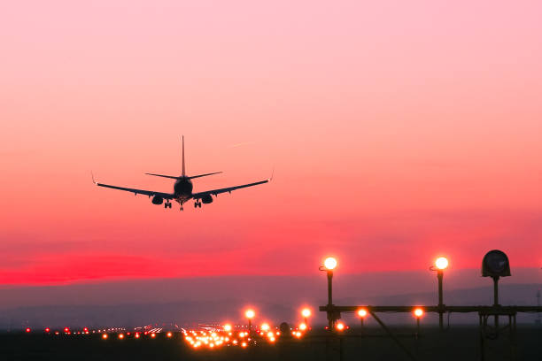
Explanatory Variables
Customer Features/Labels
Age: The actual age of the passengers

Slide 7
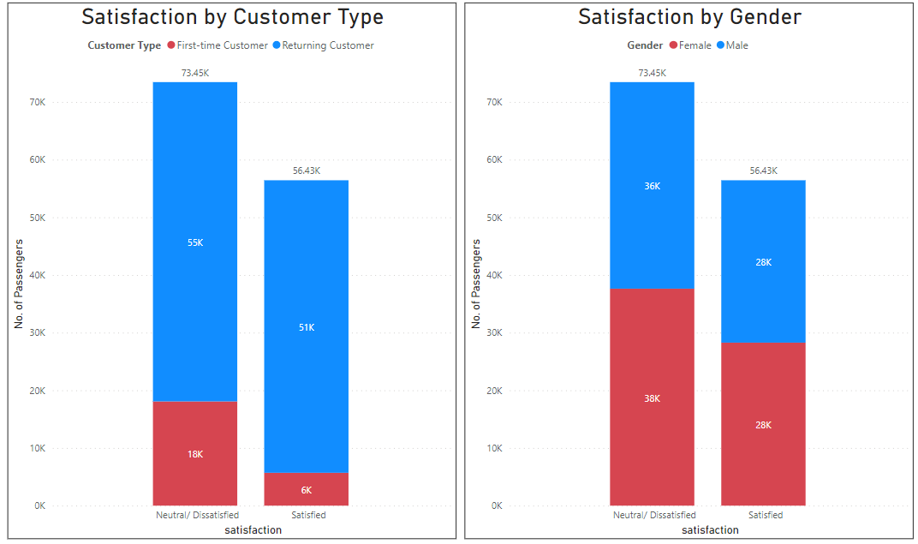
Customer Type: The customer type (Returning customer, First-time customer)
Gender: Gender of the passengers (Female, Male)

Slide 8
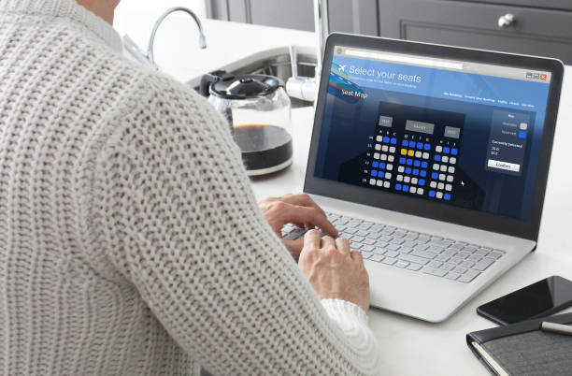
B. Trip Features/Labels
Type of Travel: Purpose of the flight of the passengers (Personal Travel, Business Travel)
Class: Travel class in the plane of the passengers (Business, Eco, Eco Plus)
Flight distance: The flight distance of this journey
Departure/Arrival time convenient: Satisfaction level of Departure/Arrival time convenient
Ease of Online booking: Satisfaction level of online booking
Gate location: Satisfaction level of Gate location
Departure Delay in Minutes: Minutes delayed when departure
Arrival Delay in Minutes: Minutes delayed when Arrival

Slide 9
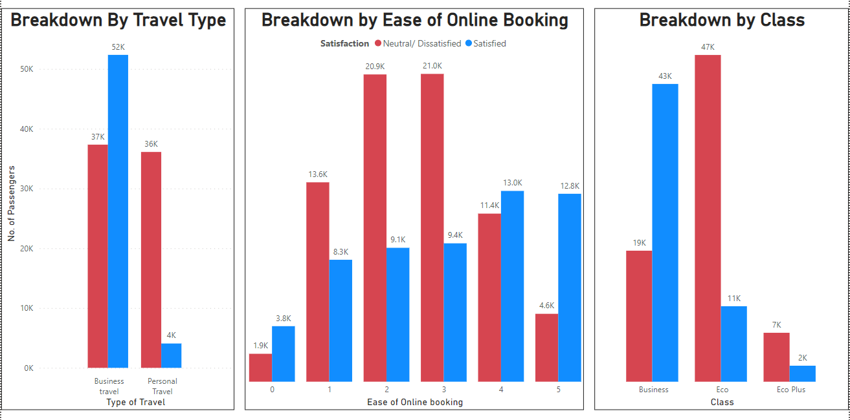

Slide 10
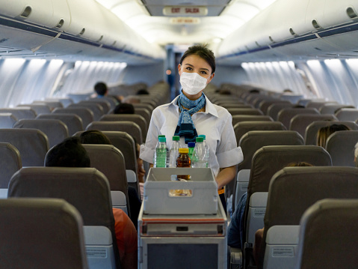
C. Service Features/Labels
Rated on a Scale of 1-5
Low: 1 to High:5
Inflight wifi service
Food and drink
Online boarding
Seat comfort
Inflight entertainment
On-board service
Leg room service
Baggage handling
Check-in service
Inflight service
Cleanliness

Slide 11
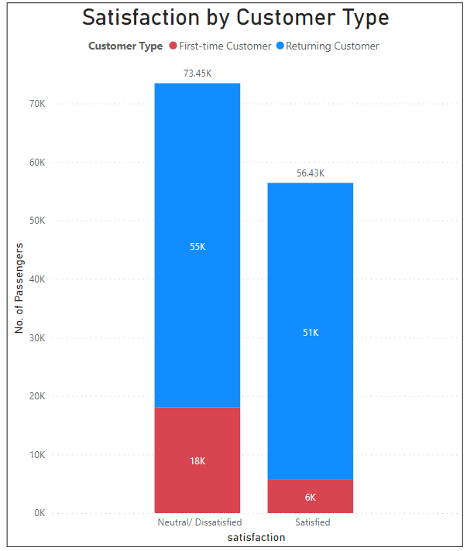
Concerns:
Returning Customers have neutral/unsatisfactory experience with the airline.
Higher percentage of First-time customers are neutral/unsatisfactory experience with the airline.
Addressing these issues can play a crucial role in determining future success.

Slide 12

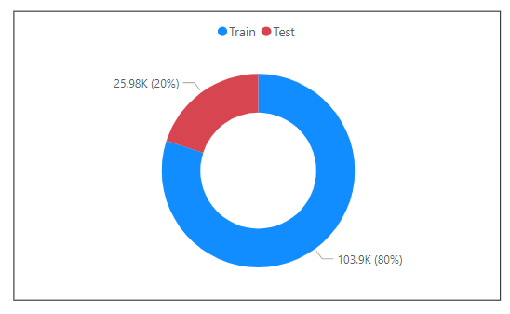
Data Cleansing
Steps:
Dropping ID column
Replacing NA values for Arrival Delay with Median Value = 0.0
Test/Train Split: 80/20
Reason:
Balanced Dataset with no Temporal data
Clean Dataset with few NA values

Slide 13
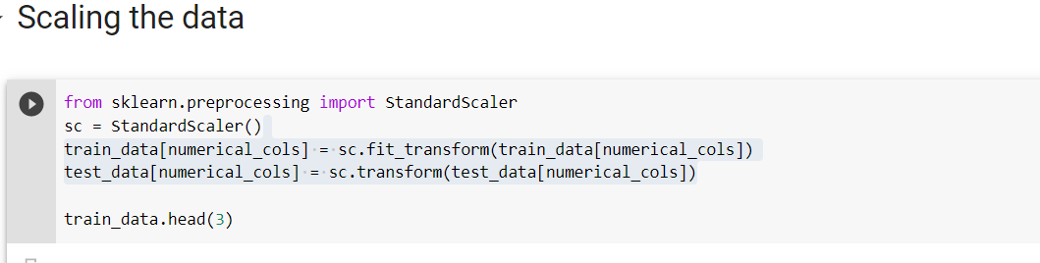
Data Normalization
Why?
High variance between some attributes would result in model assigning additional weight to the model
Scaling performed on: Numerical Columns only

Slide 14
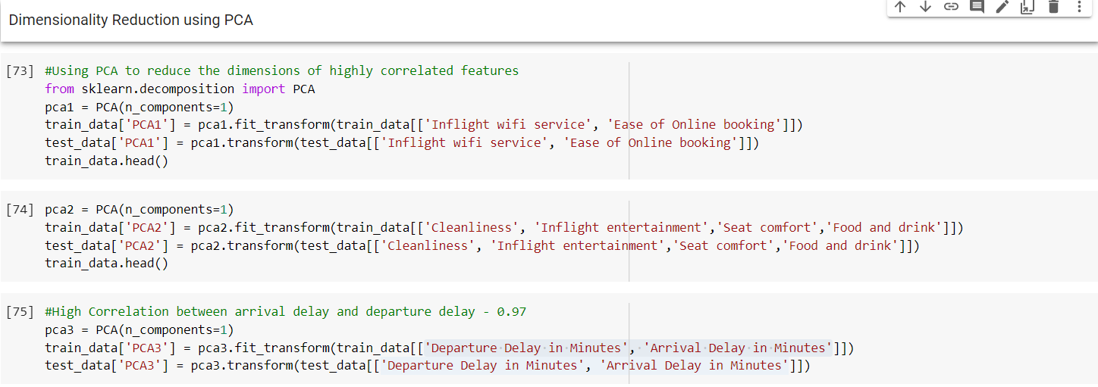
Feature Reduction using PCA
Why: High Correlation between the following Attribute Pairs:
Inflight wifi service & Ease of Online booking
Cleanliness, Inflight entertainment, Seat comfort, Food and drink
Departure Delay in Minutes, Arrival Delay in Minutes
How many PCA: 3 Pairs

Slide 15
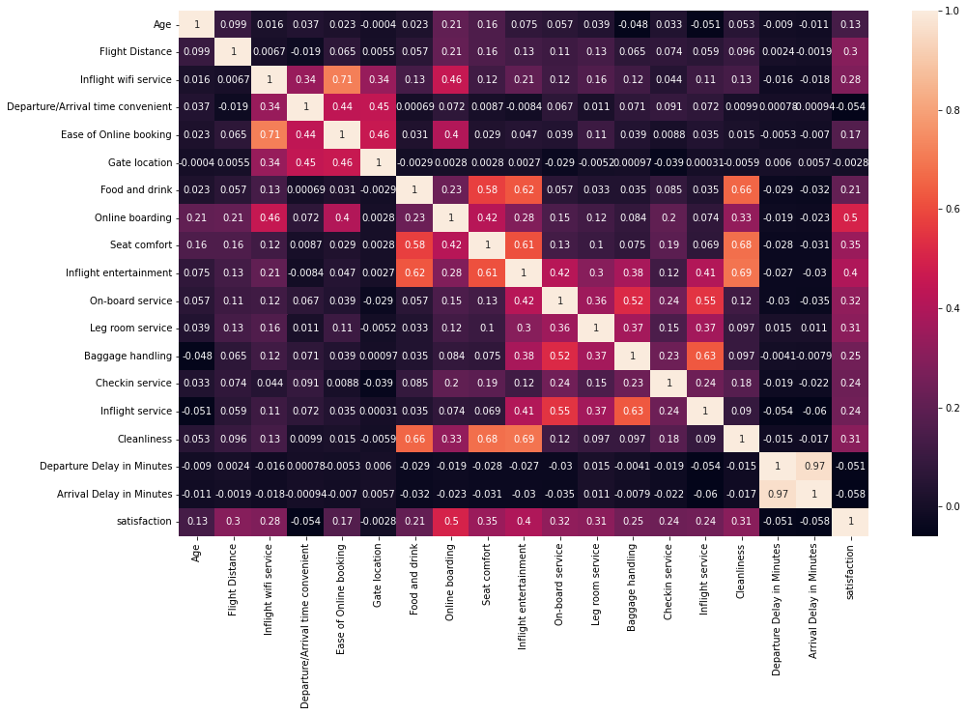
Before PCA

Slide 16
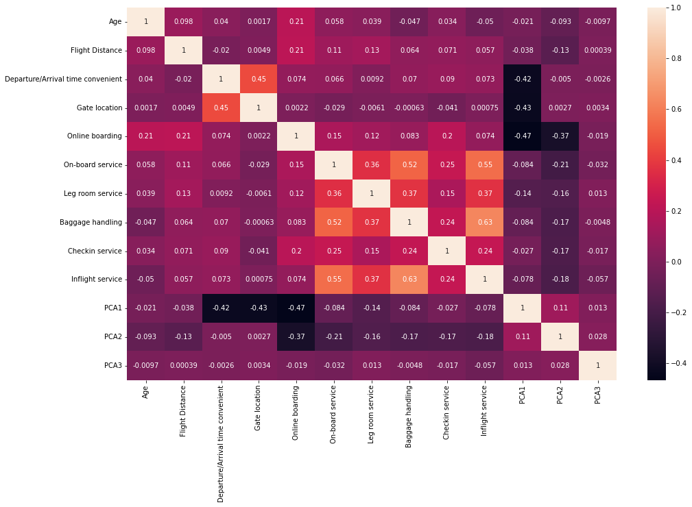
After PCA

Slide 17
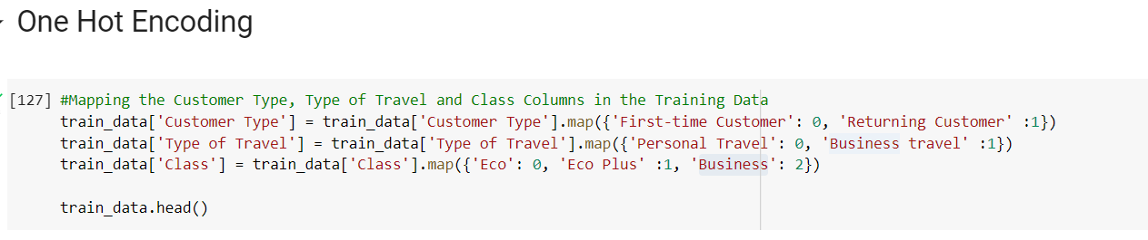
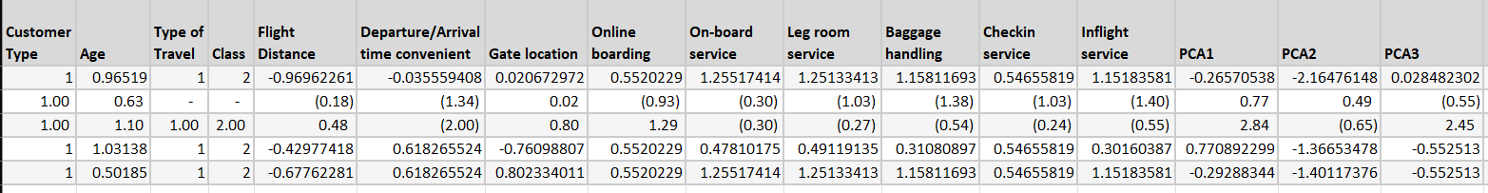

Slide 18
Observation Exclusion
Around 28% observations (all outliers) excluded
Why ?
Semantic Incongruence : They might present a curious new case and needs to be examined separately
E.g. - Outliers in Departure delays (delay >360 minutes) might imply flight been cancelled !

Slide 19

Dealing with ‘Missing Values’
NUMERICAL DATA : Replaced with mean
E.g. Departure Delay in minutes
CATEGORICAL DATA: Replaced with mode
E.g. - Type of Travel
No observations excluded owing to missingness

Slide 20
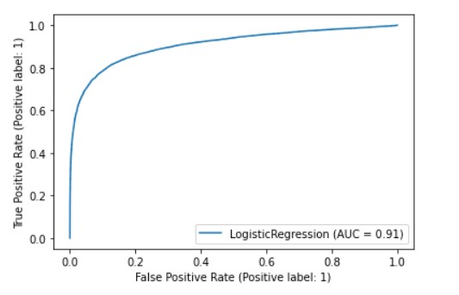
Logistic Regression Model
X1 | Type of travel
X2 | Online Boarding
X3 | Seat Comfort
X4 | Flight distance
X5 | Inflight Entertainment
X6 | On Board Service
X7 | Legroom Service
X8 | Cleanliness
X9 | Check-in Service
X10 | Inflight service
X11 | Baggage Handling
X12 | Departure Delay
12 parameters used
All were significant
Accuracy with AUC was 91%

Slide 21
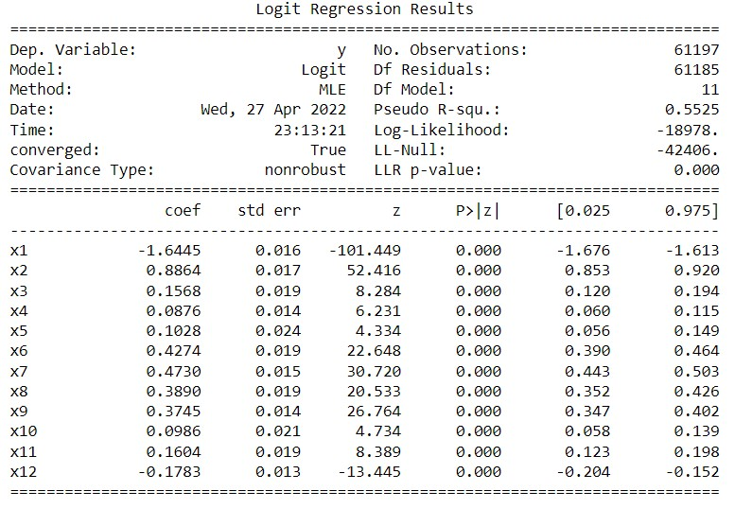
Logistic Regression

Slide 22
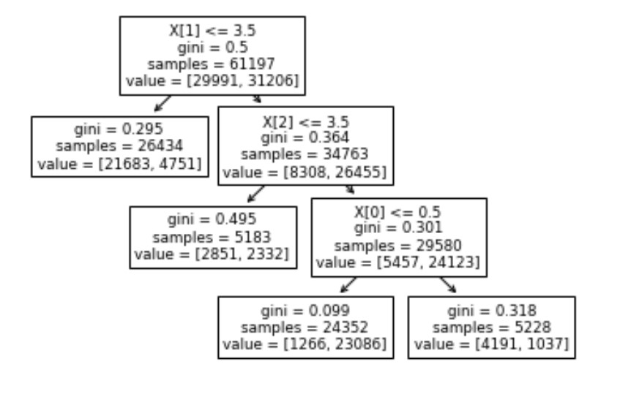
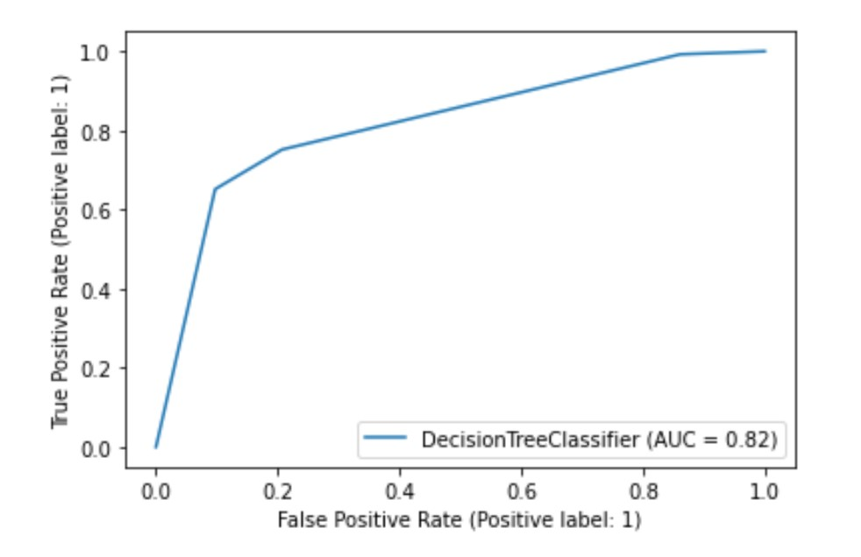
Decision Tree
Dissatisfied
Satisfied
First Split or X[1]:Online Boarding,
Second Split or X[2]: Seat Comfort
Third Split or X[3] : Type of Travel
AUC: 0.82
Criteria used : Gini
Maximum Leaf Nodes: 4

Slide 23
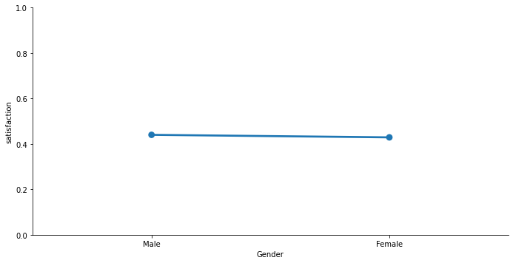
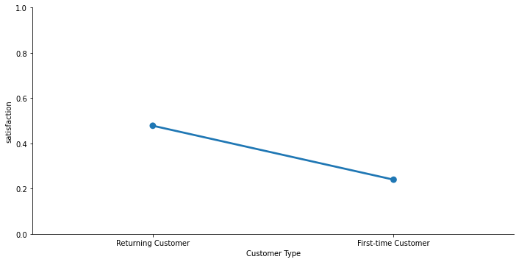
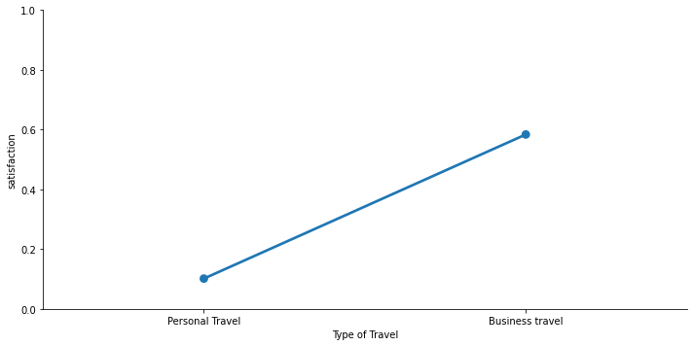
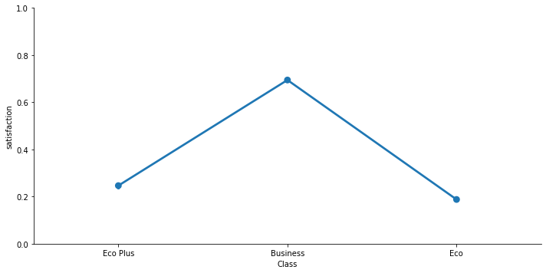
Some important Observations

Slide 24
Feature Selection
The data was segregated into categorical and numerical features. By visualizing specific trends in the data we were able to gain the following insights:
Gender doesn't play an important role in the satisfaction, as men and women seems to equally concerned about the same factors so we dropped the column/attribute of gender
Number of returning/loyal customers for this airline is high, however, the dissatisfaction level is high irrespective of the loyalty. Airline will have to work on maintaining the loyal/returning customers.
Age and Gate location does not play a huge role in satisfaction for a customer so we dropped those columns as well.

Slide 25
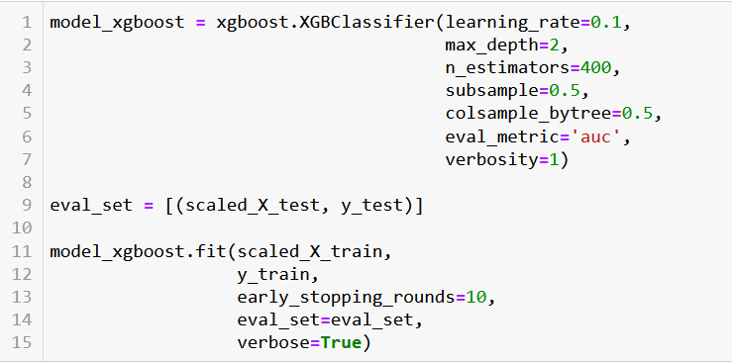
XGboost model
AUC Train: 0.9805
AUC Test: 0.9802

Slide 26
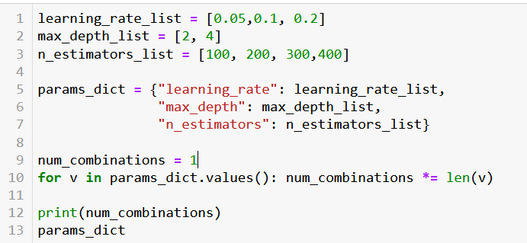
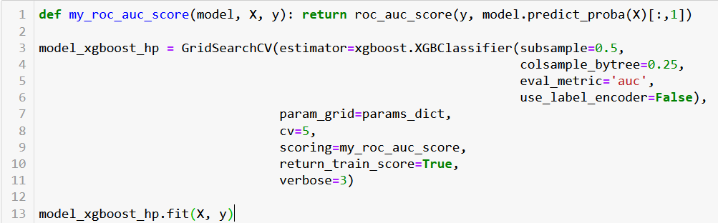
Gridsearch

Slide 27
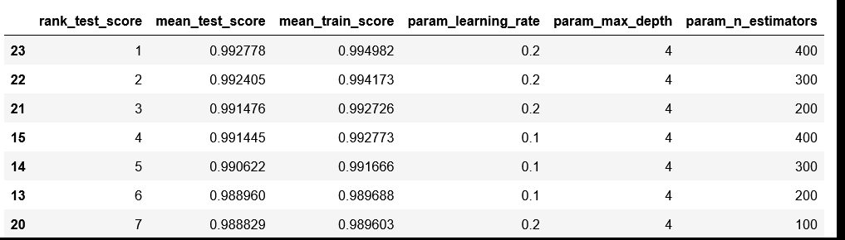
Sorting by Mean Validation Scores

Slide 28
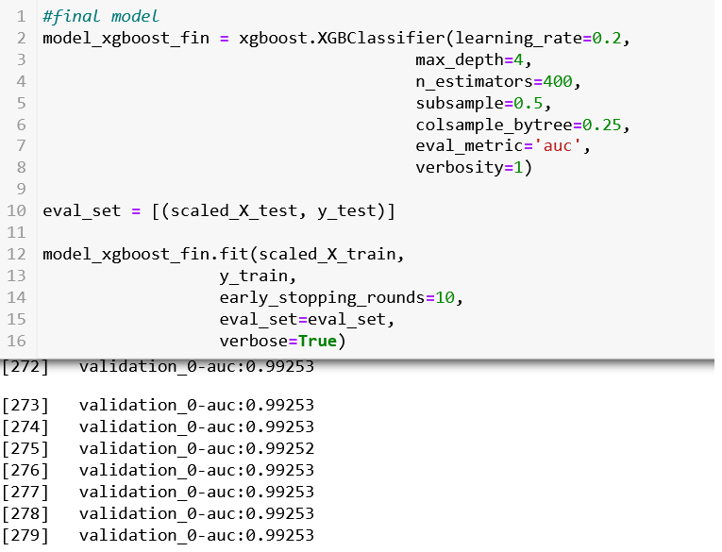
Accuracy on Train Sample

Slide 29
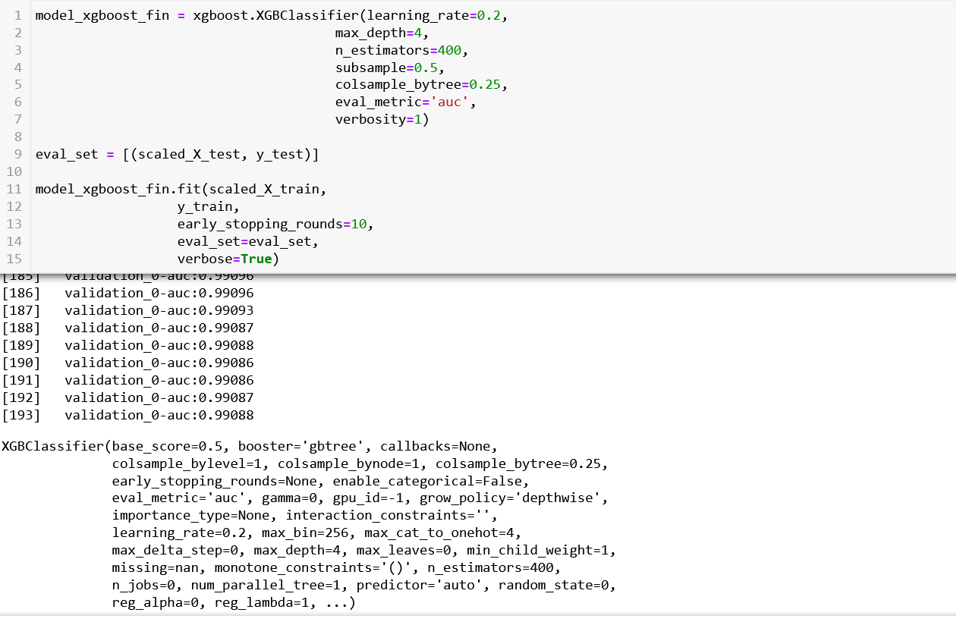
Accuracy on Test Sample

Slide 30
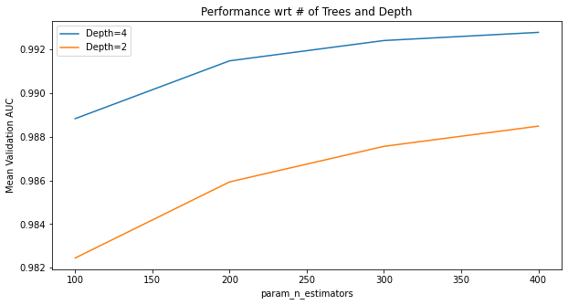
Based on the performance metrics shown in the previous table, we choose the best model with learning rate of 0.2 and maximum depth of 4 as it gives us the highest mean train and validation scores.Also a graph comparing performance of the model w.r.t number of trees and depth and Mean validation AUC scores. From the below graph we can infer that the mean validation AUC increases as we increase the max depth, which gives us a good basis for the parameters to be selected for our final xgboost model.

Slide 31
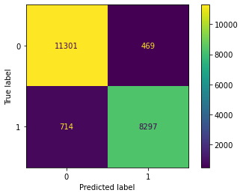

Before Grid Search
After Grid Search

Slide 32
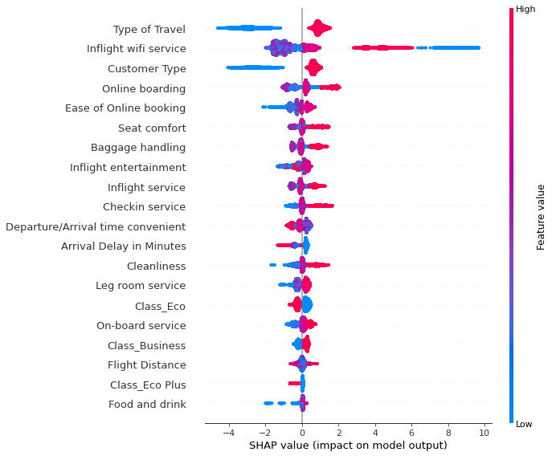
SHAP Summary Plot

Slide 33
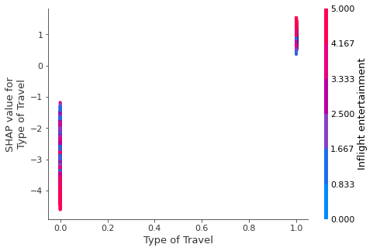
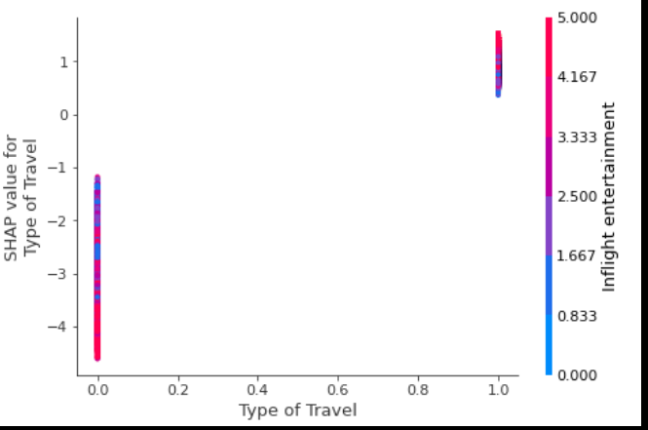
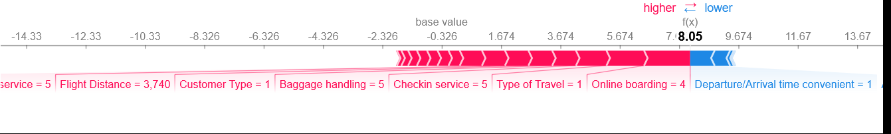
SHAP dependence plots
Individual SHAP plot on the most important feature

Slide 34
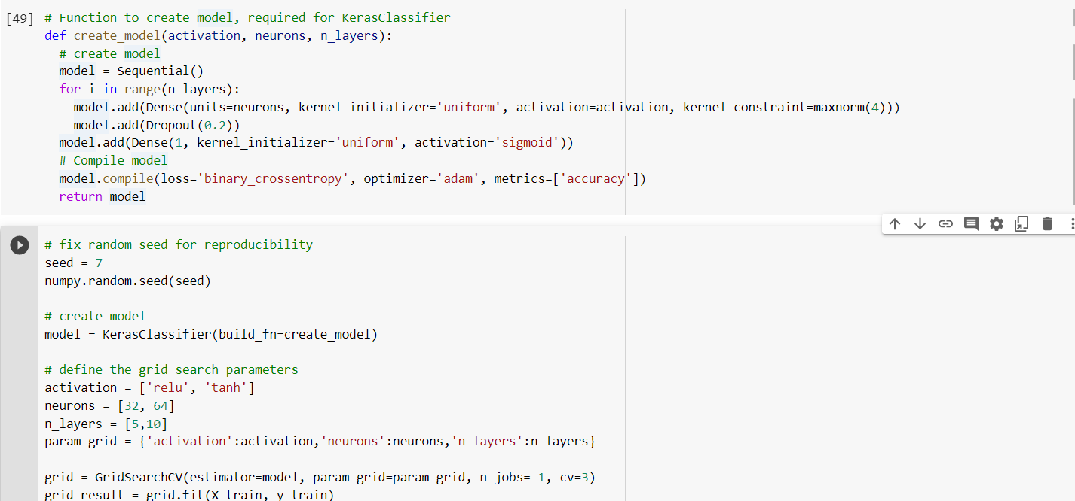
Neural Network

Slide 35
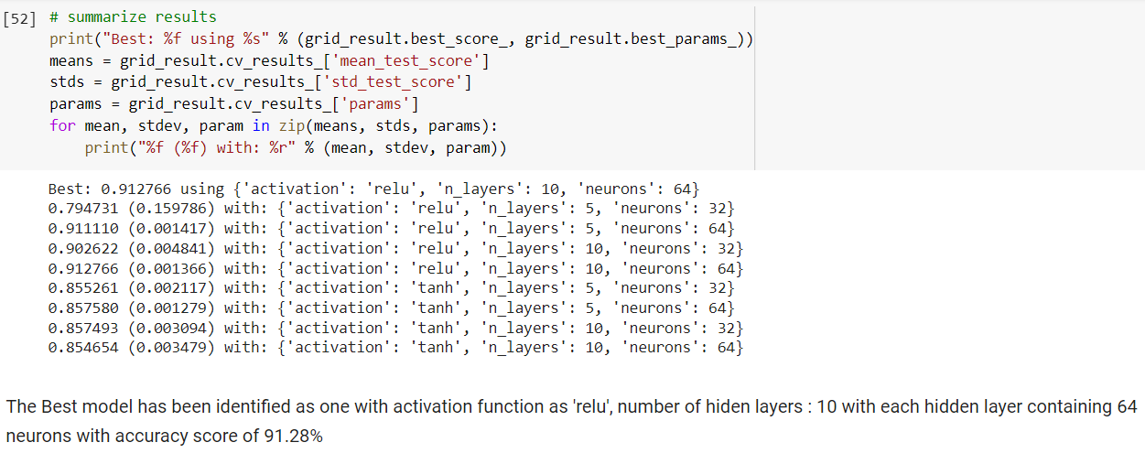
Results

Slide 36
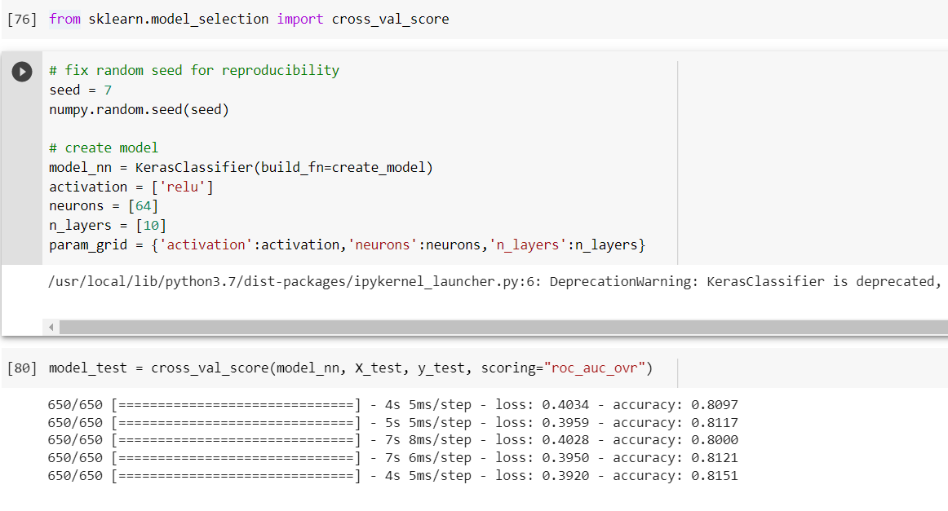
Running Grid-search recommendation on Test Sample

Slide 37
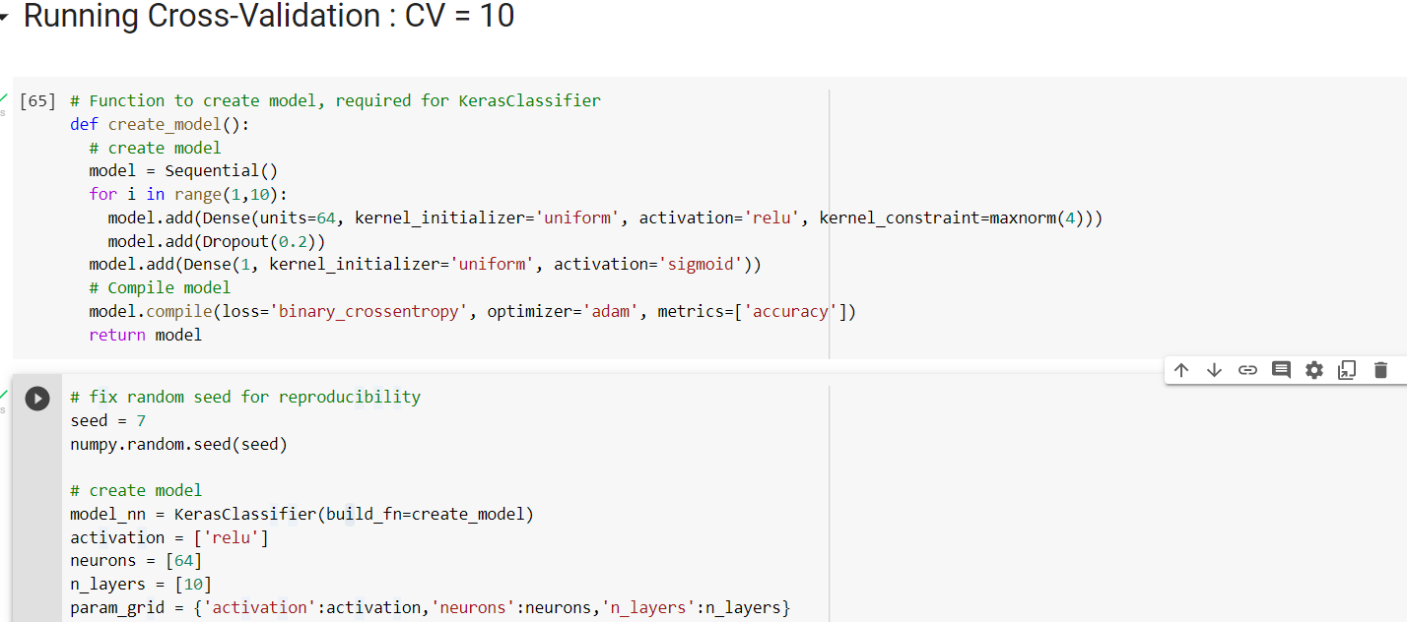
Neural Network
Building our model with cv = 10

Slide 38
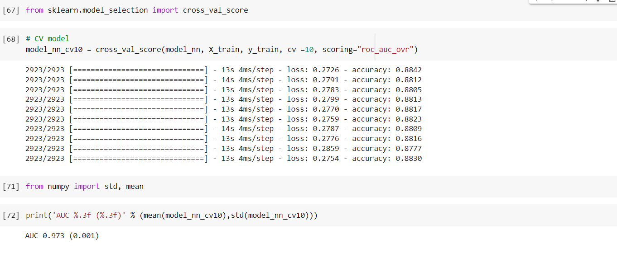
Results

Slide 39
Conclusion
Based on the results of the XGBoost & Neural Network:
We prefer the XGBoost Model over the Neural network based on accuracy.
Airlines should highly focus on inflight wi-fi experience.
Satisfaction also depends on the minimizing travel delays.
Provide promotional offers to business travelers as they bring most business
Ease of online booking is important for all customers.
In the future, collect even more data to improve neural networks for both high precision and recall

